Slide 1
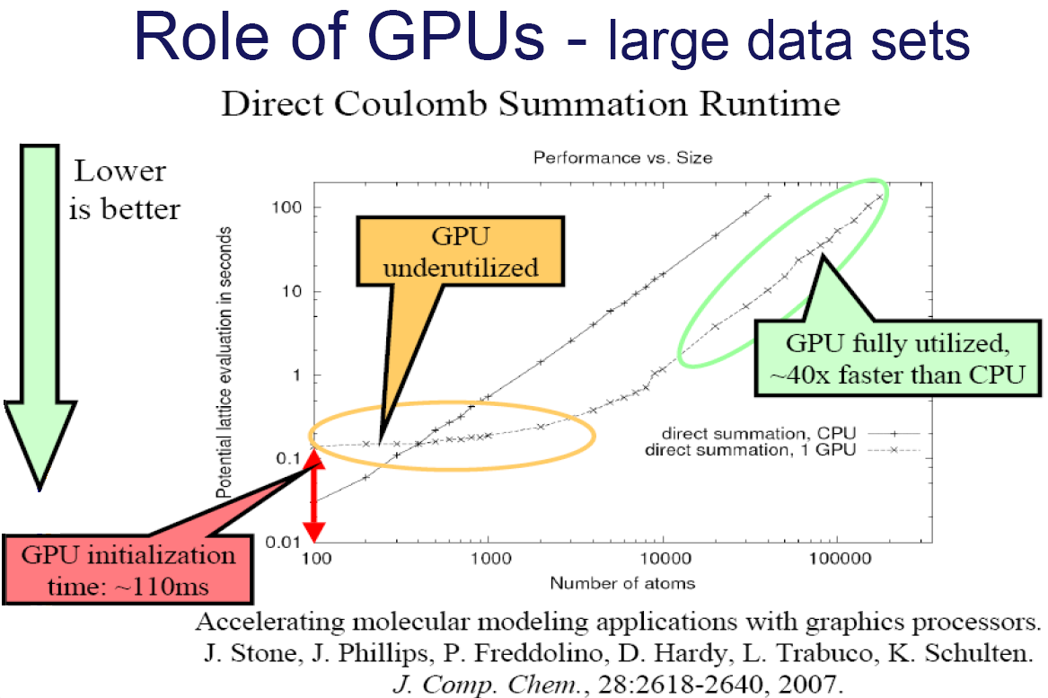

Slide 2
CPUs and GPUs have fundamentally different design philosophies
Control
ALU
ALU
ALU
ALU
CPU
GPU
Cache
DRAM
DRAM

Slide 3
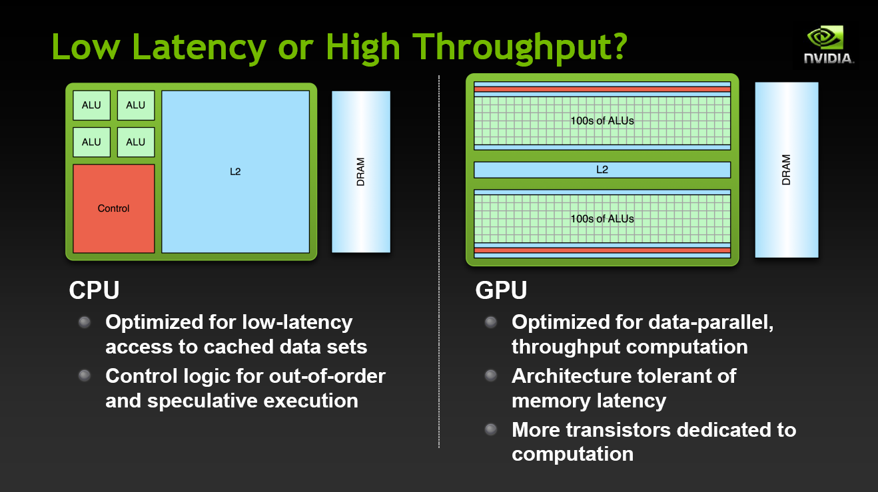

Slide 4
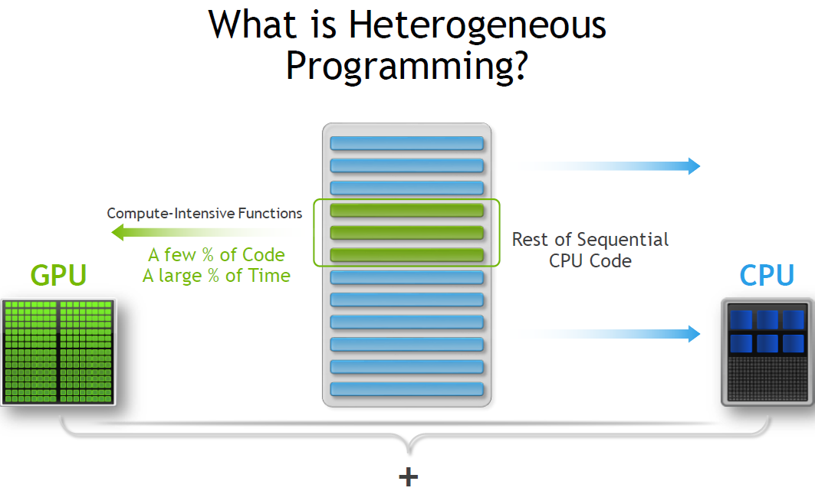

Slide 5
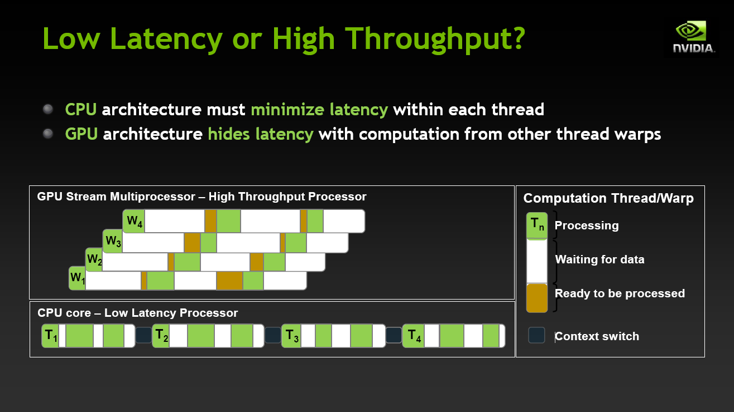

Slide 6
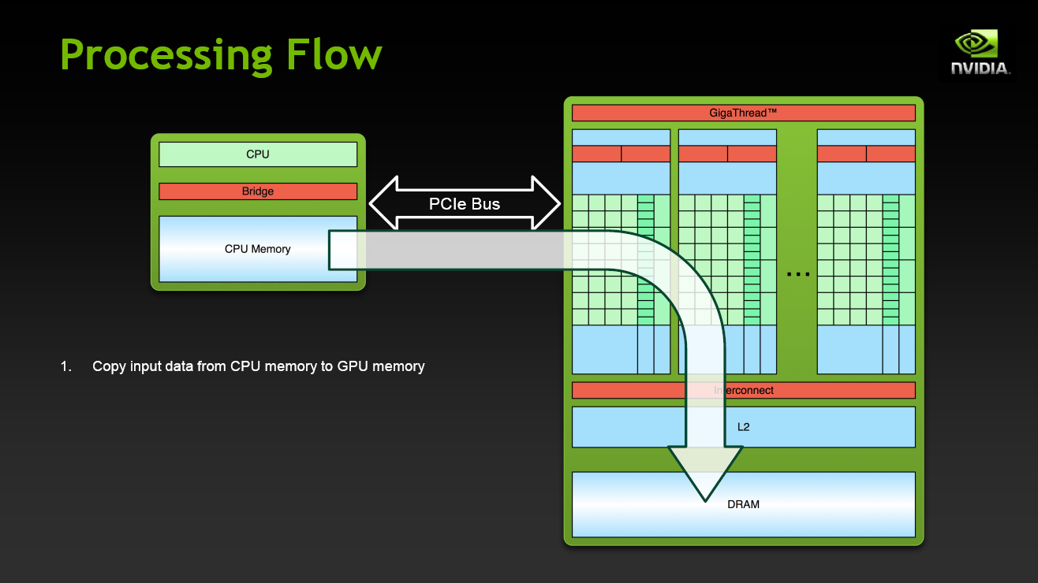

Slide 7
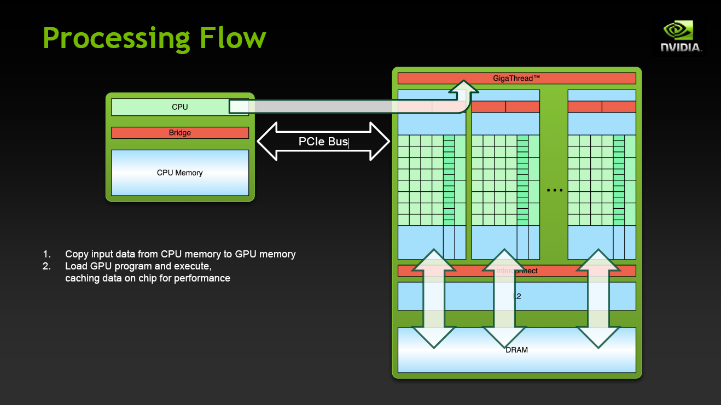

Slide 8
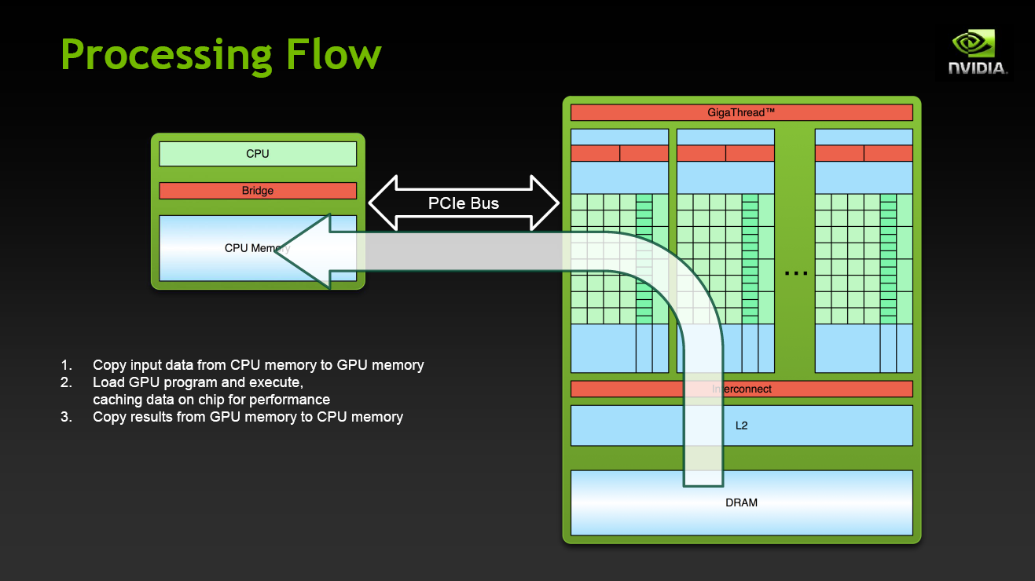

Slide 9

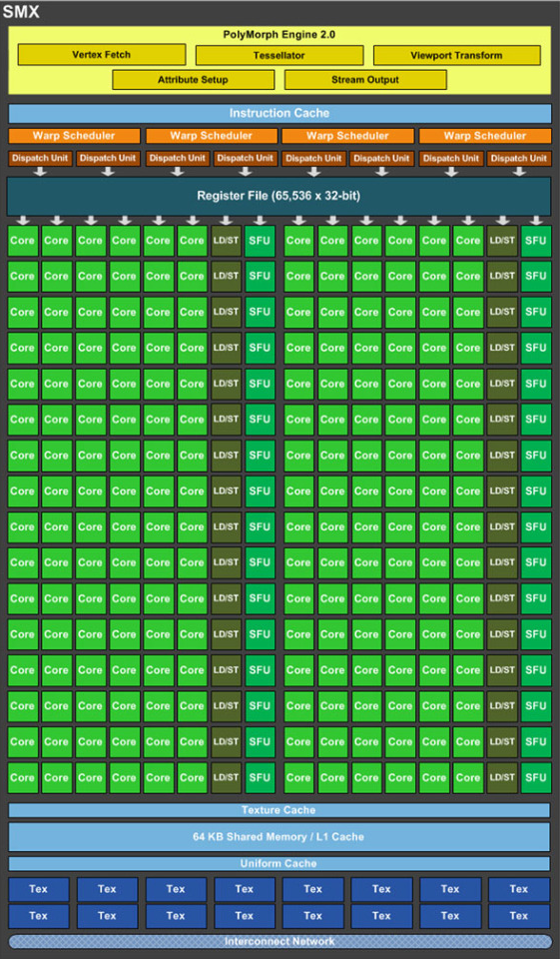
Nvidia Kepler
192 Floating Point processing units per streaming multiprocessor
256KB Level 2 Cache
Introduction of dynamic parallelism scheduler
Multiple kernel execution with scheduling

Slide 10
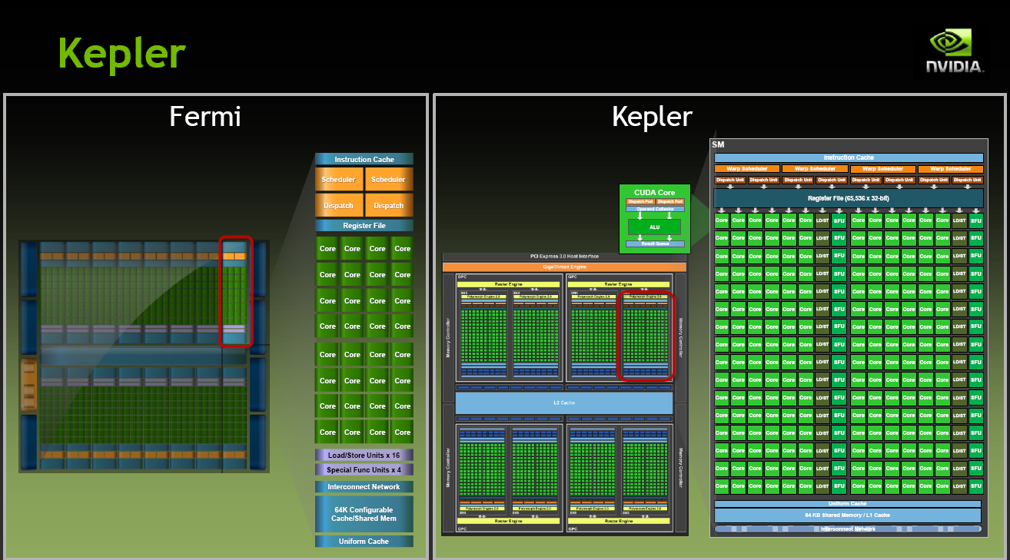

Slide 11
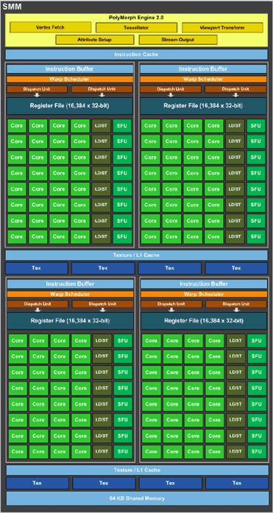
Nvidia Maxwell
128 Floating Point processing units per streaming multiprocessor
2MB Level 2 Cache
Massive Power Usage Reduction
Native shared memory atomic operations and CAS
Isolated Warp Scheduling

Slide 12
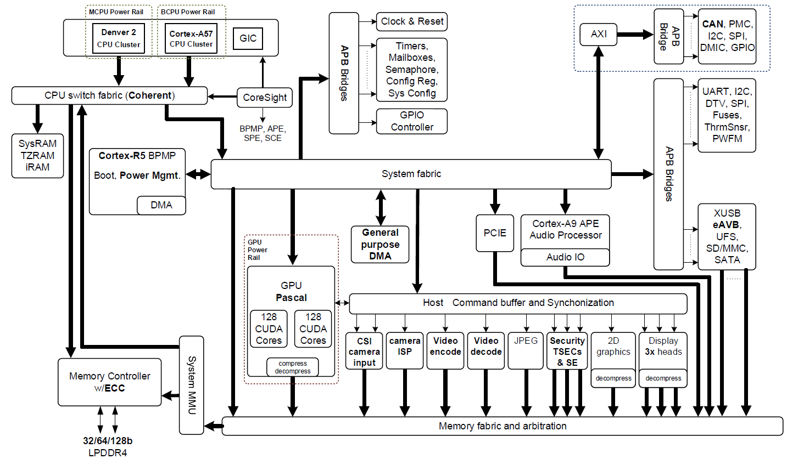
NVIDA TX2 Configuration

Slide 13
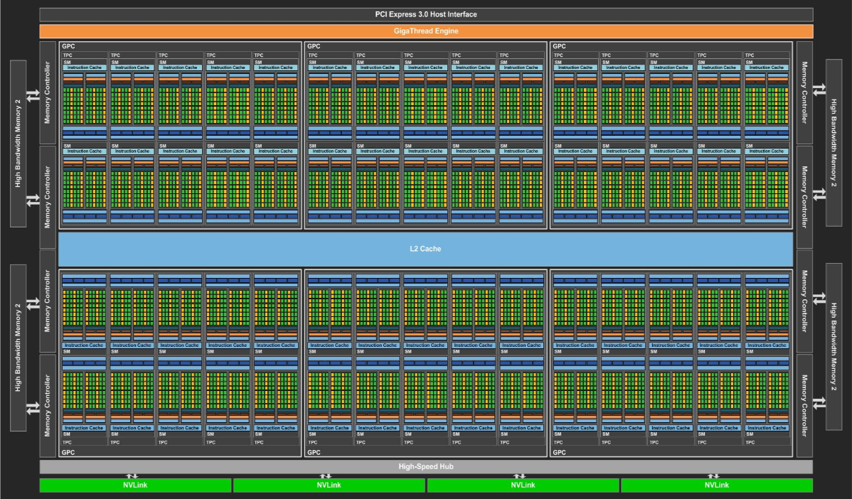
NVIDIA PASCAL GP100

Slide 14


Slide 15
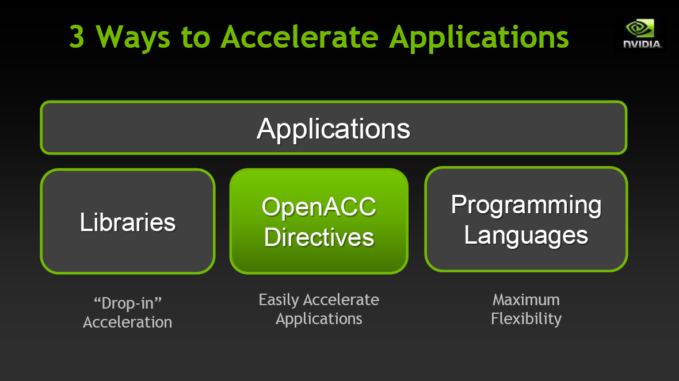

Slide 16
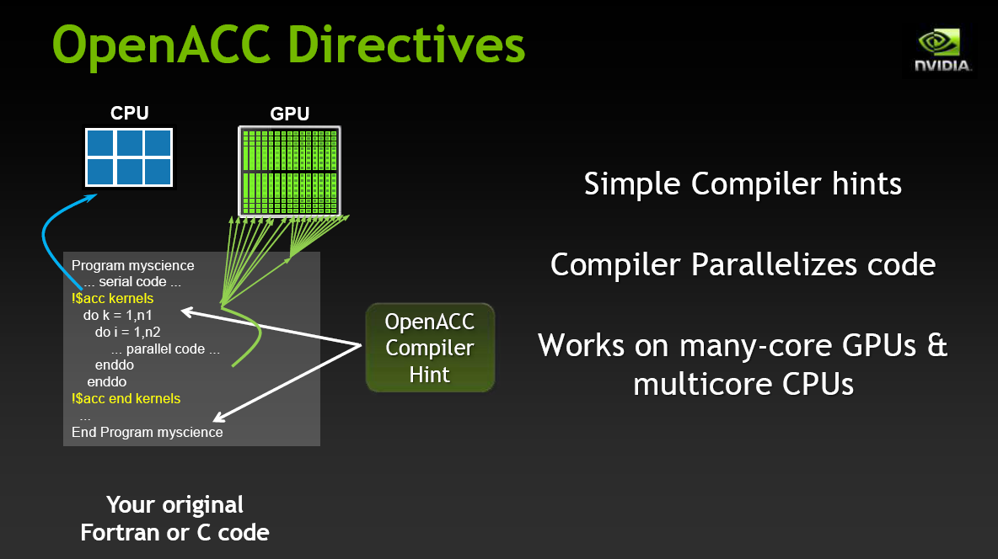

Slide 17
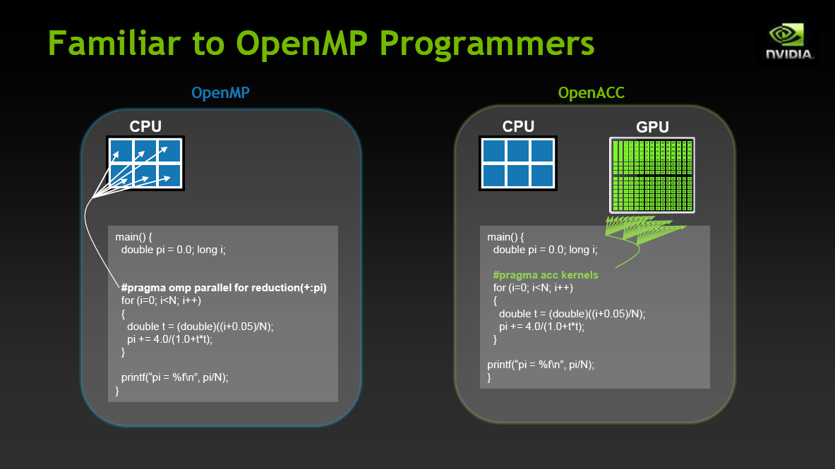

Slide 18
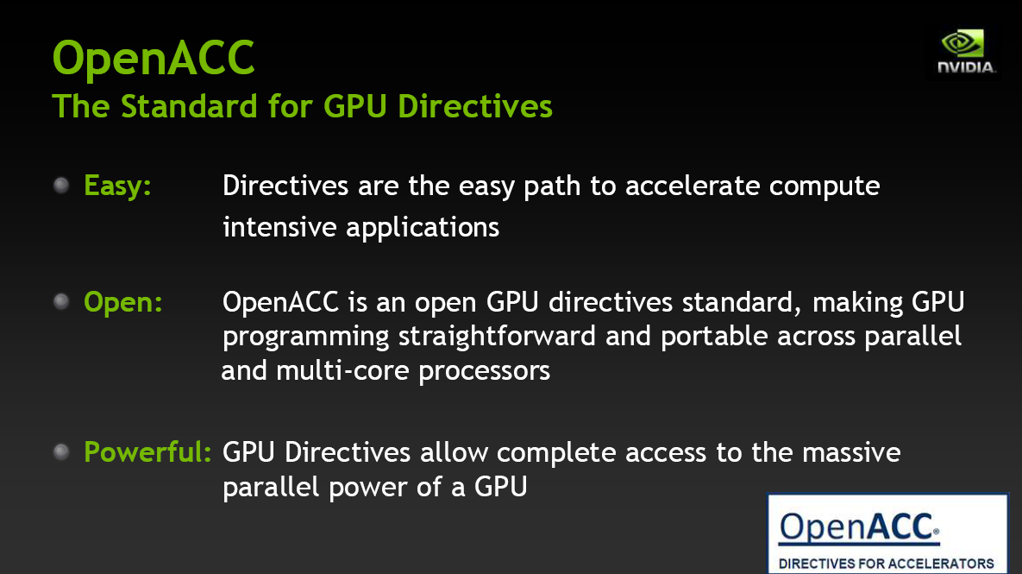

Slide 19
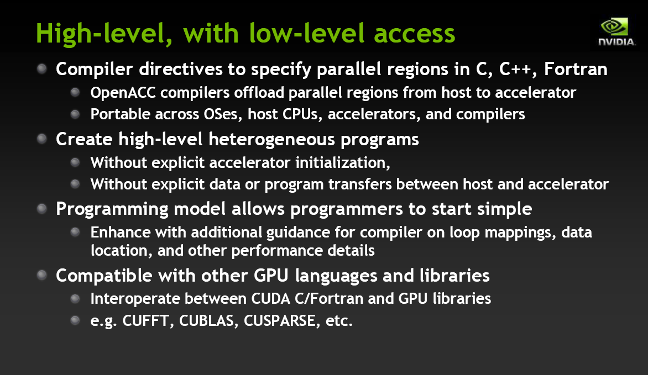

Slide 20
OpenMP
An accepted standard developed in the late 1990s by a group of industry specialists.
Consists of a small set of compiler directives, augmented with a small set of library routines and environment variables using the base language Fortran and C/C++.
The compiler directives can specify such things as the par and forall operations described previously.

Slide 21
Fork-Join Parallelism but thread based:
Master thread spawns a team of threads as needed
Parallelism can be added incrementally
sequential program evolves into a parallel program
Master Thread
Parallel Regions

Slide 22
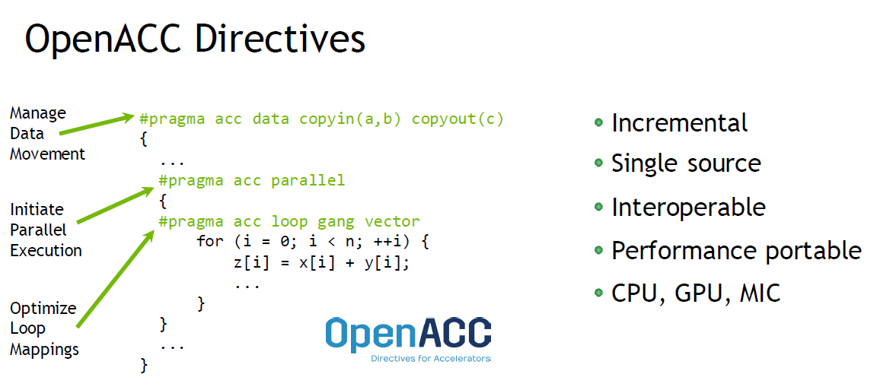

Slide 23
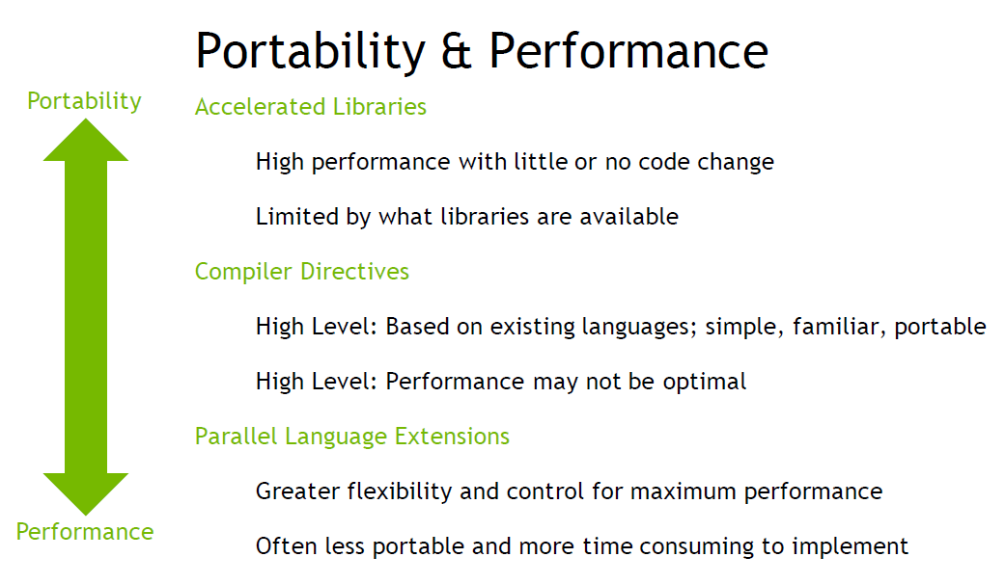

Slide 24
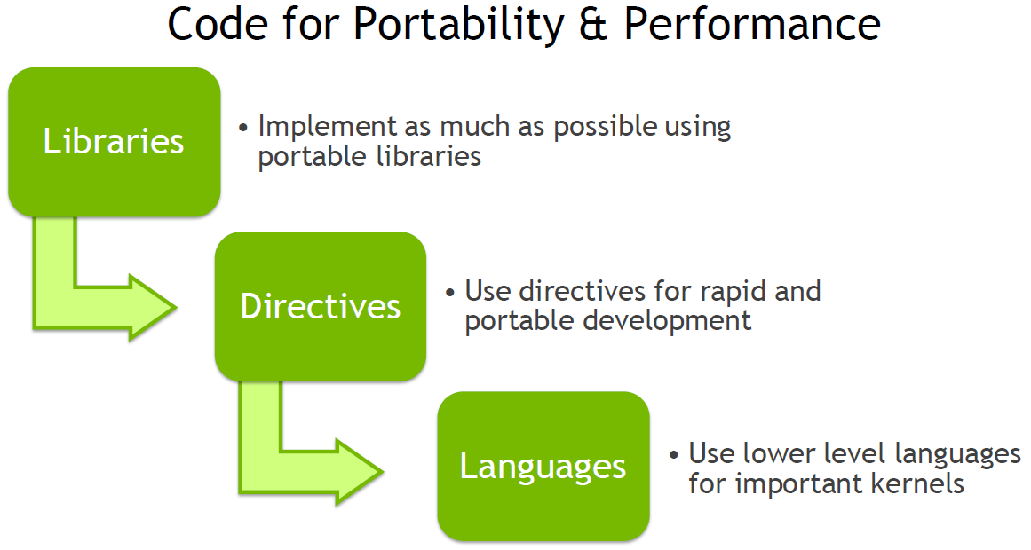

Slide 25
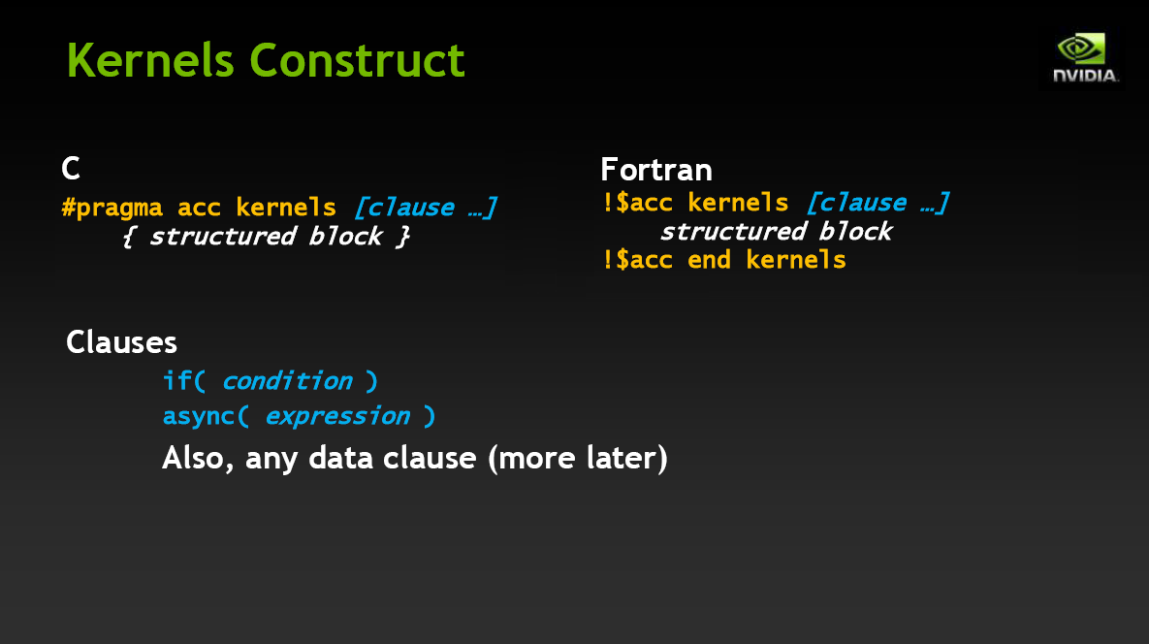

Slide 26
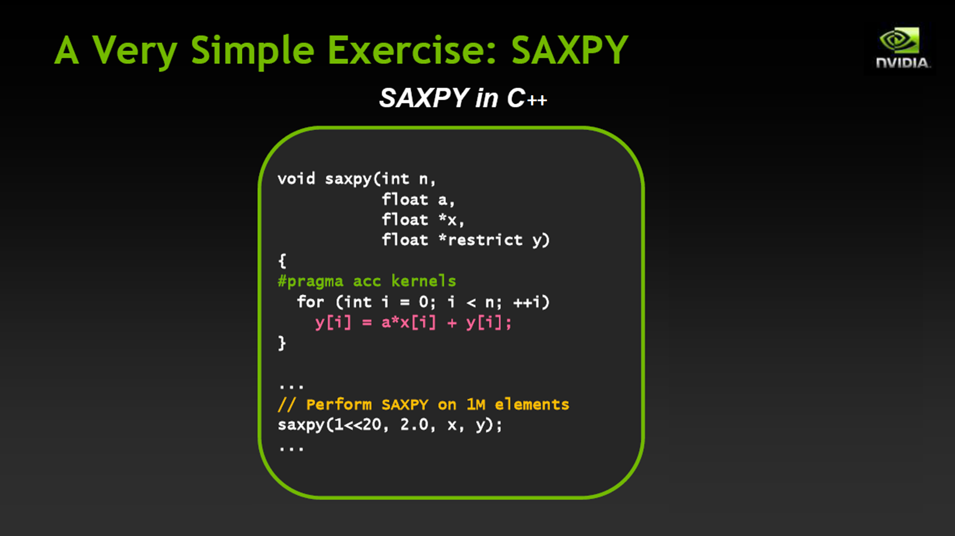

Slide 27
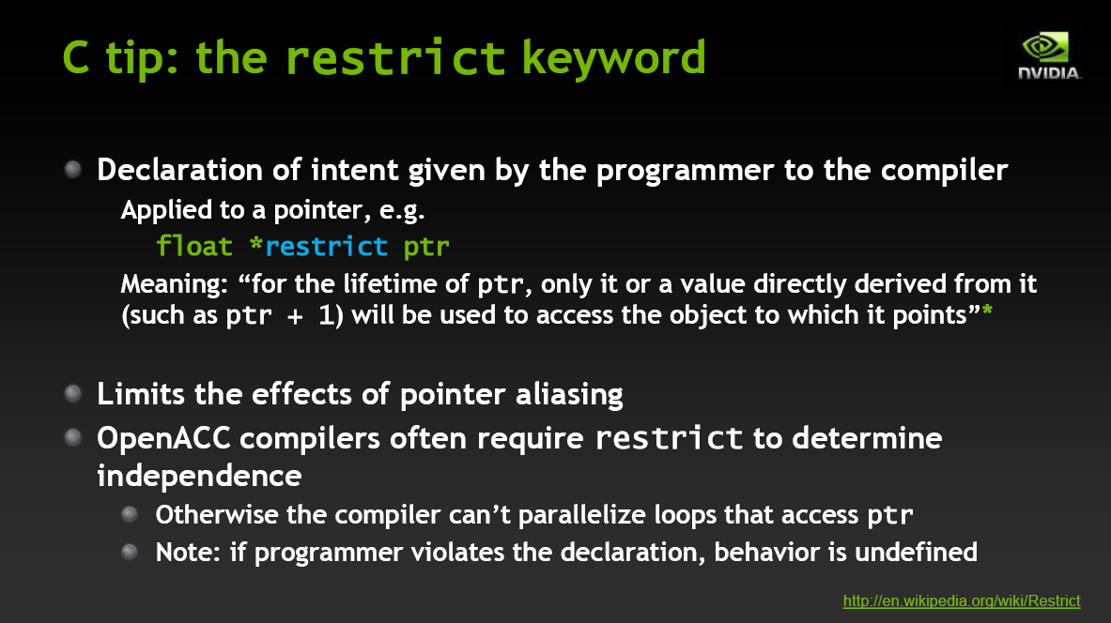

Slide 28
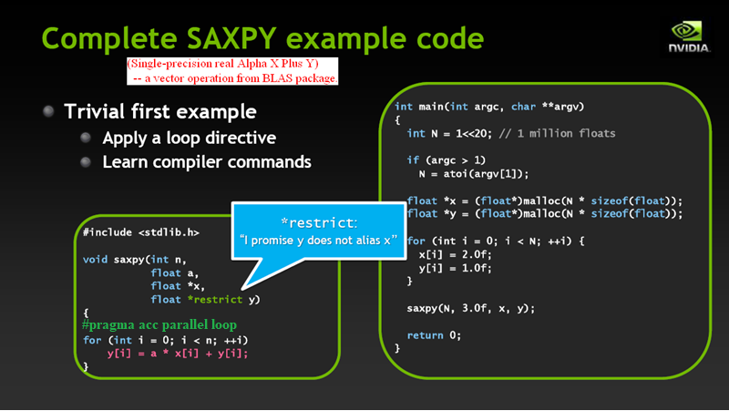

Slide 29
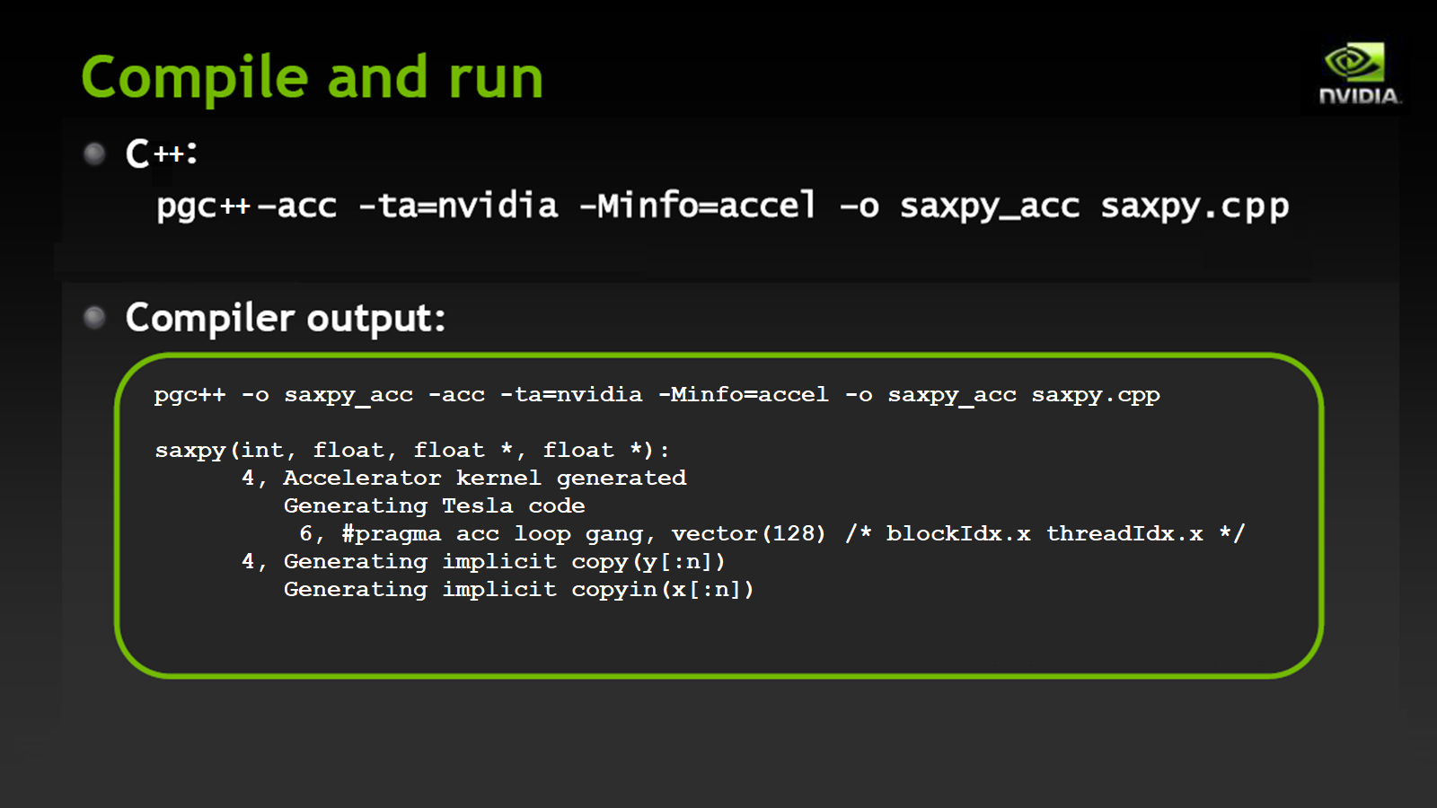

Slide 30


Slide 31
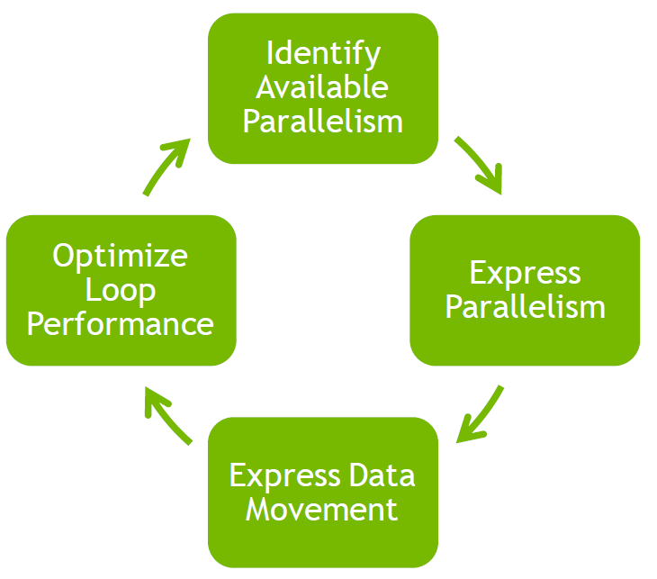

Slide 32
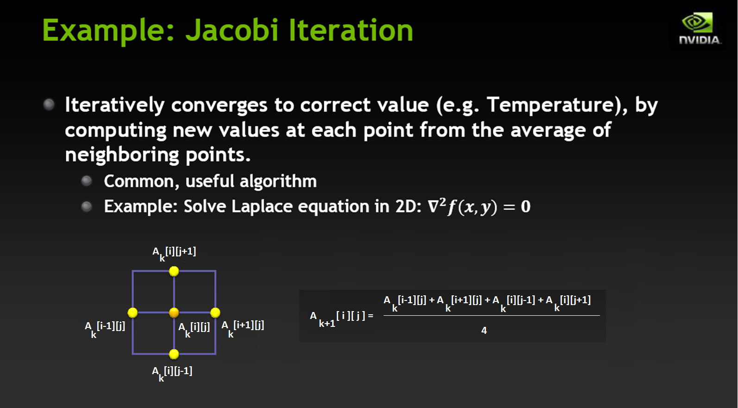

Slide 33

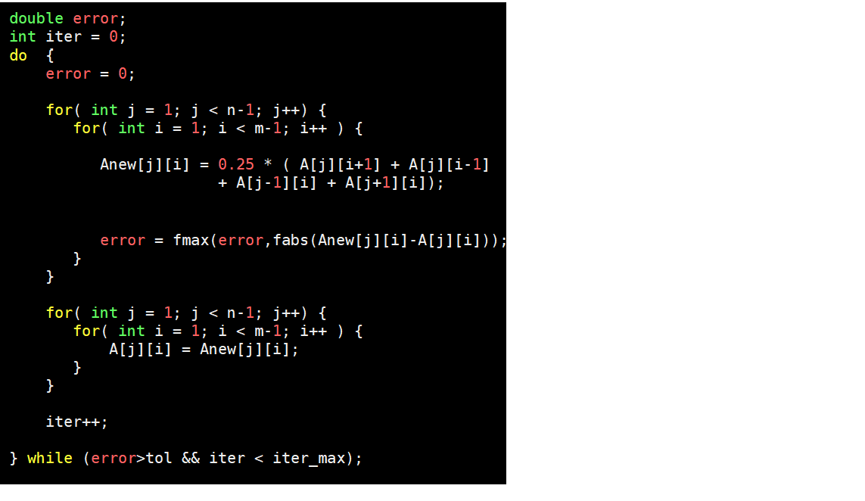
Jacobi Iteration 2D C++ Code

Slide 34
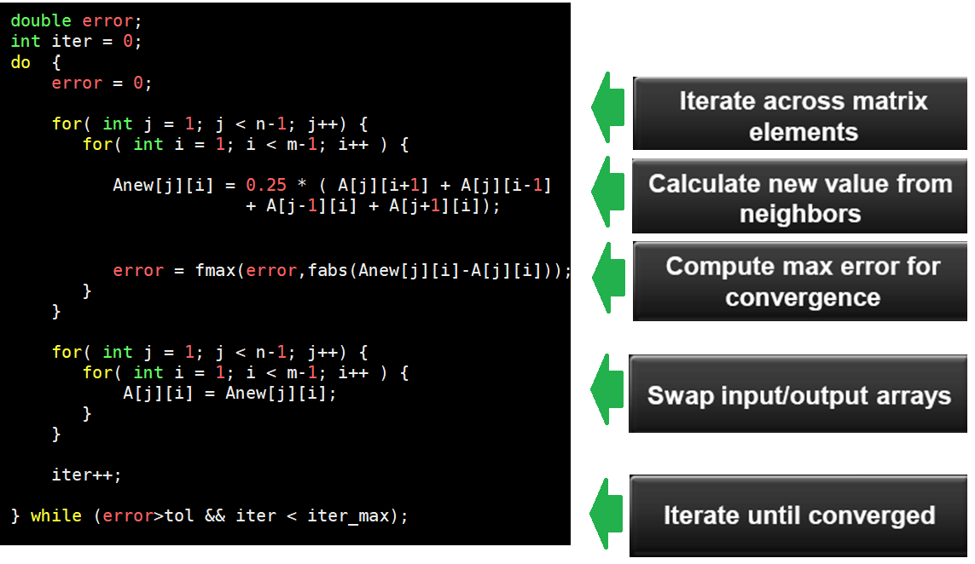
Jacobi Iteration 2D C++ Code

Slide 35
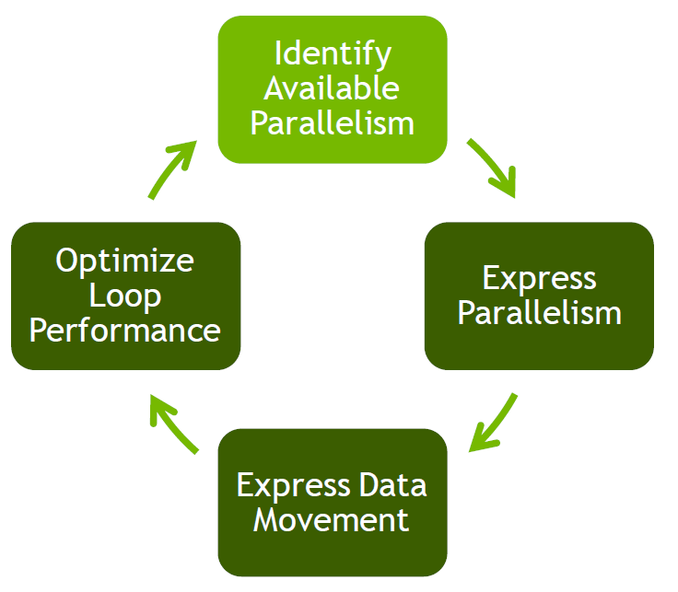

Slide 36
2D Jacobi Iteration – Identify Parallelism

Slide 37
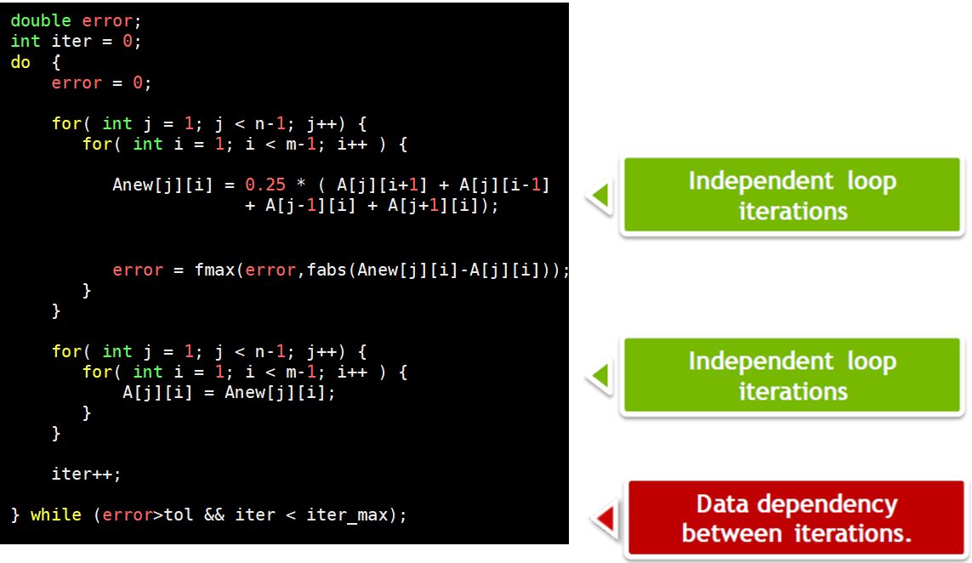
2D Jacobi Iteration – Identify Parallelism

Slide 38
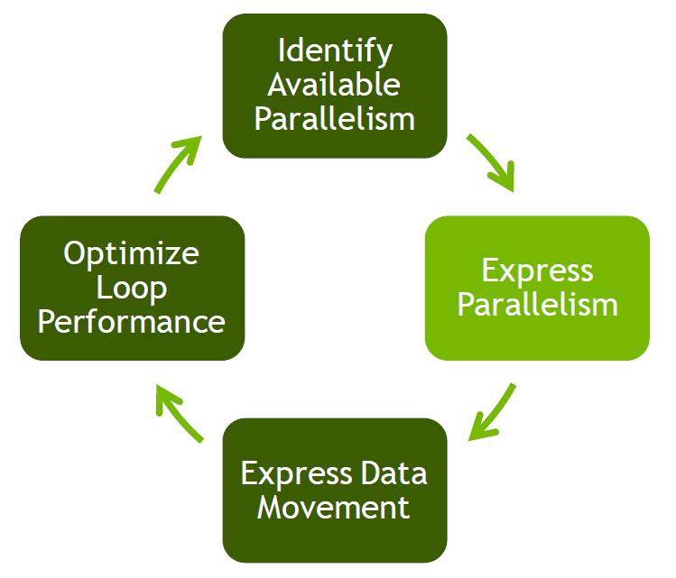

Slide 39
2D Jacobi Iteration – Express Parallelism

Slide 40
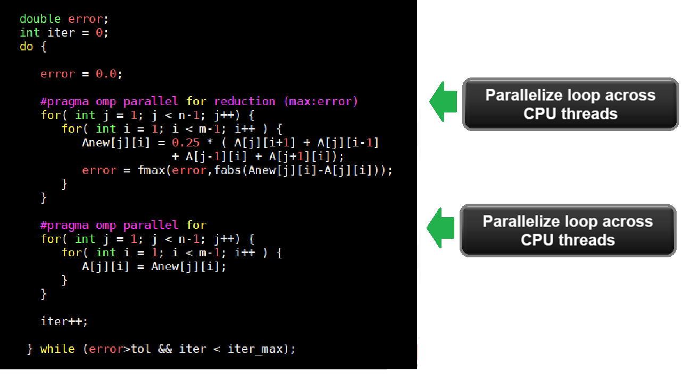
2D Jacobi Iteration – Express Parallelism OpenMP Solution

Slide 41
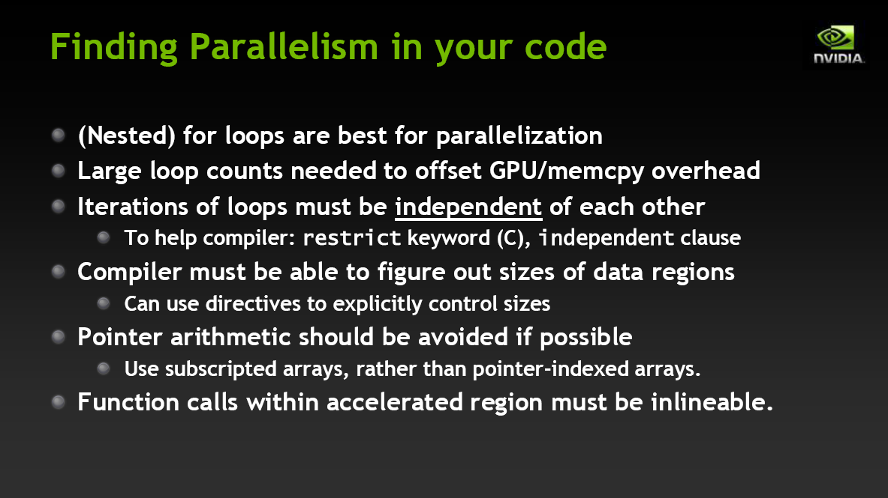

Slide 42
OpenACC Parallel Directive
Starts parallel execution on accelerator
Specified by:
#pragma acc parallel [clause [,clause]…] new-line
structured block
When encountered:
Gangs of workers threads are created to execute on accelerator
One worker in each gang begins executing the code following the structured block
Number of gangs/workers remains constant in parallel region

Slide 43
OpenACC Parallel Directive
The clauses for the #pragma acc parallel directive are:
if( condition)
async [(scalar-integer-expression)]
num_gangs (scalar-integer-expression)
num_workers (scalar-integer-expression)
vector_length (scalar-integer-expression)
reduction (operator:list)
copy (list)
copyout (list)
create (list)
private (list)
firstprivate (list)

Slide 44
OpenACC Loop Directive
Used to describe what type of parallelism to use to execute the loop in the accelerator.
Can be used to declare loop-private variables, arrays and reduction operations.
Specified by:
#pragma acc loop [clause [,clause]…] new-line
for loop

Slide 45
OpenACC Loop directive clauses
collapse clause
Specifies how many tightly nested loops are associated with the loop construct.
seq clause
Specifies that a loop needs to be executed sequentially by the accelerator.
independent clause
Specifies that there are no data dependences in the loop.
private clause
Specifies that a copy of each item on the list will be created for each iterations of the loop.
reduction clause
Specifies that a reduction need to be perform associated to a gang, worker or vector.
tile clause
Breaks the next 1 or more loops into tiles based upon the specified dimensions.

Slide 46
2D Jacobi Iteration – Express Parallelism OpenMP Solution

Slide 47
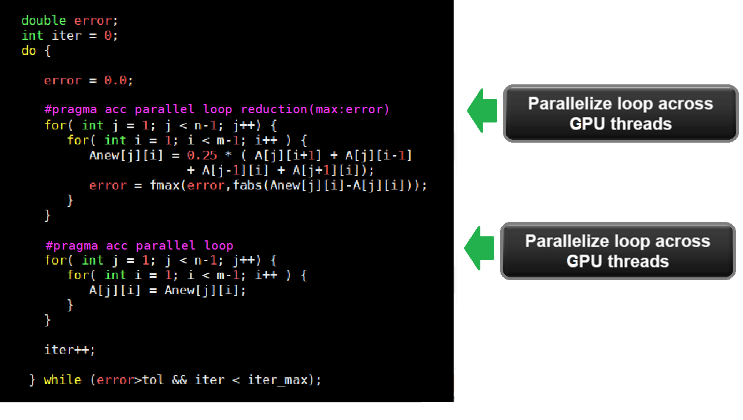
2D Jacobi Iteration – Express Parallelism OpenACC Solution

Slide 48
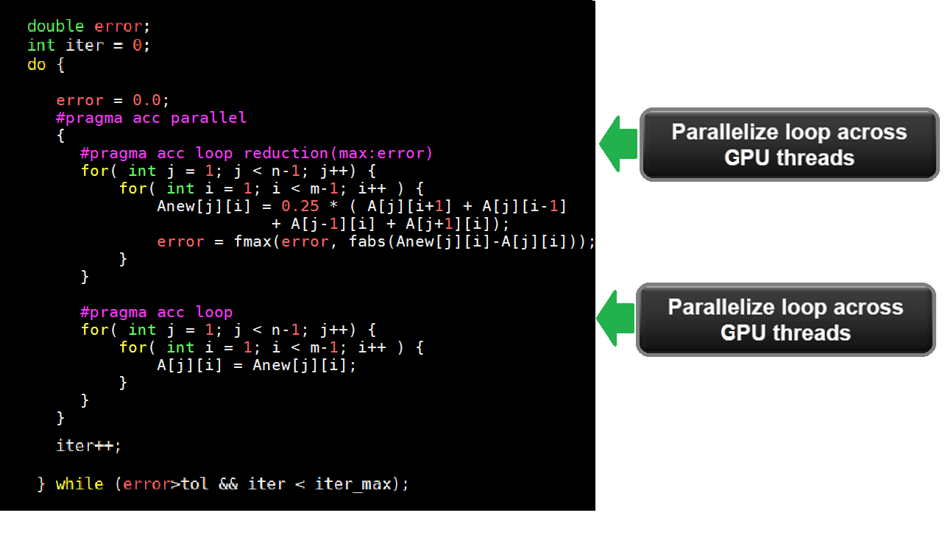
2D Jacobi Iteration – Express Parallelism OpenACC Solution – common parallel section

Slide 49
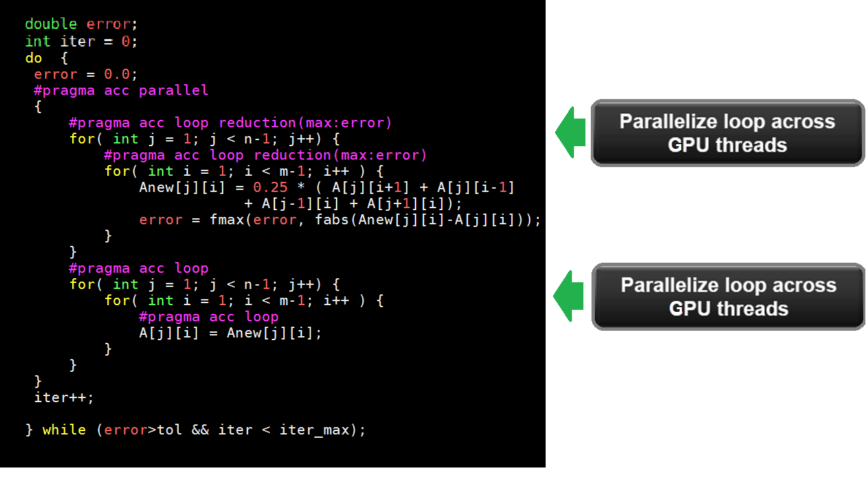
2D Jacobi Iteration – Express Parallelism OpenACC Solution – more expressive solution

Slide 50
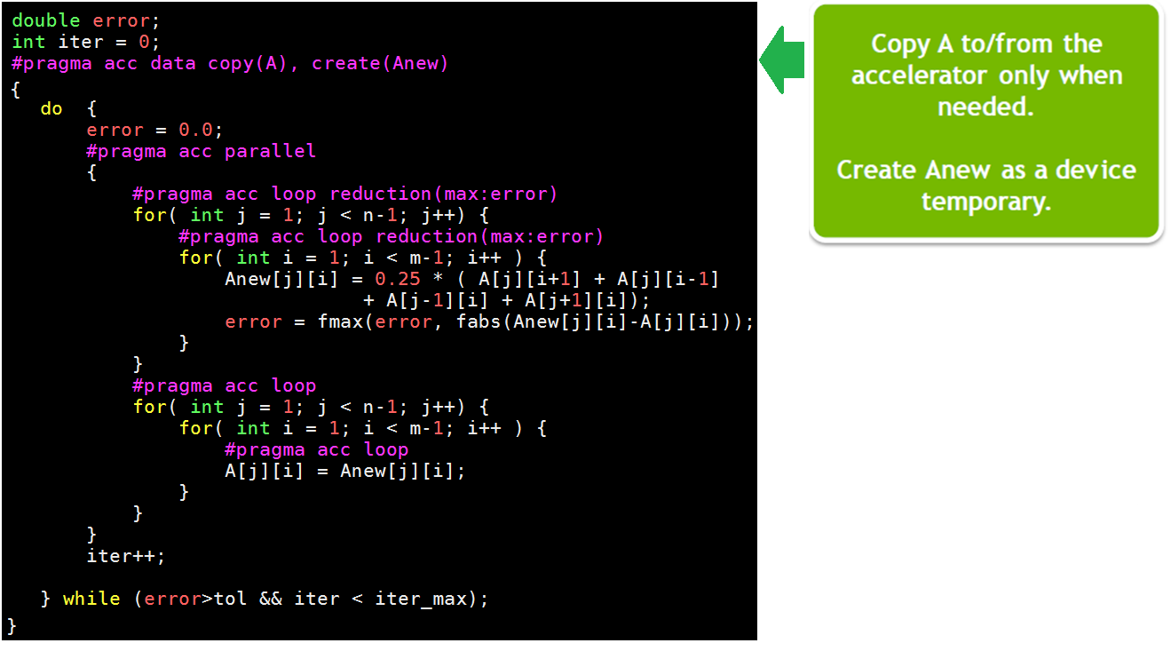
2D Jacobi Iteration – Express Parallelism OpenACC Solution – common parallel section

Slide 51
Building the Code
pgc++ laplace2d_acc.cpp -o laplace2d_acc -acc -ta=nvidia -Minfo=accel -lm -fast
main:
72, Accelerator kernel generated
Generating Tesla code
74, #pragma acc loop gang /* blockIdx.x */
Generating reduction(max:error)
76, #pragma acc loop vector(128) /* threadIdx.x */
83, #pragma acc loop gang /* blockIdx.x */
85, #pragma acc loop vector(128) /* threadIdx.x */
72, Generating implicit copyin(A[:][:])
Generating implicit copyout(A[1:4094][1:4094])
Generating implicit copy(error)
Generating implicit copyout(Anew[1:4094][1:4094])
76, Loop is parallelizable
85, Loop is parallelizable

Slide 52
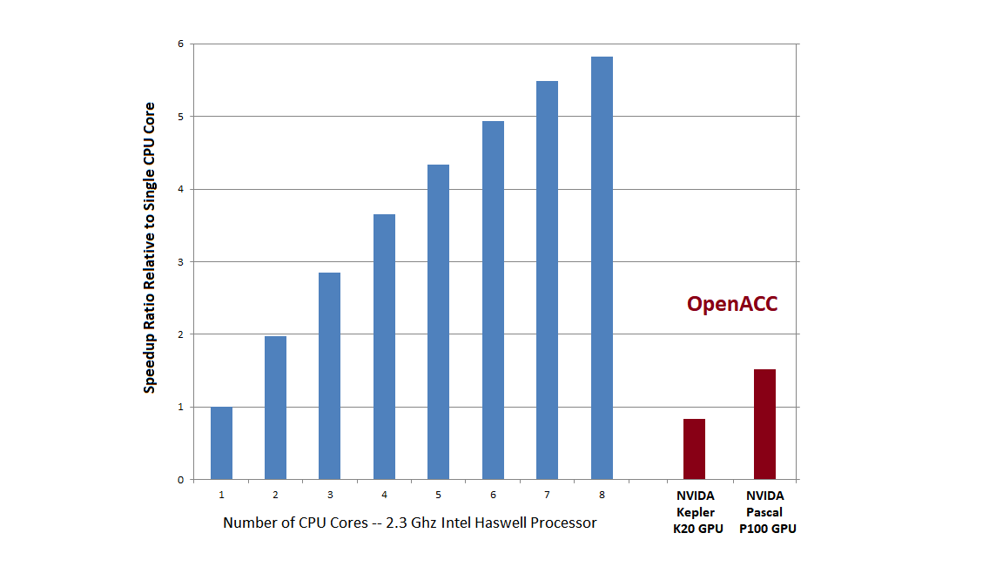
2D Laplace Measured Speedup OpenMP and OpenACC

Slide 53
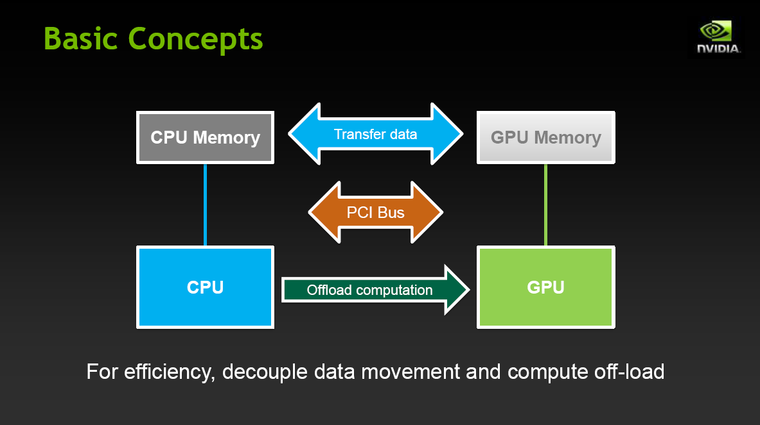

Slide 54
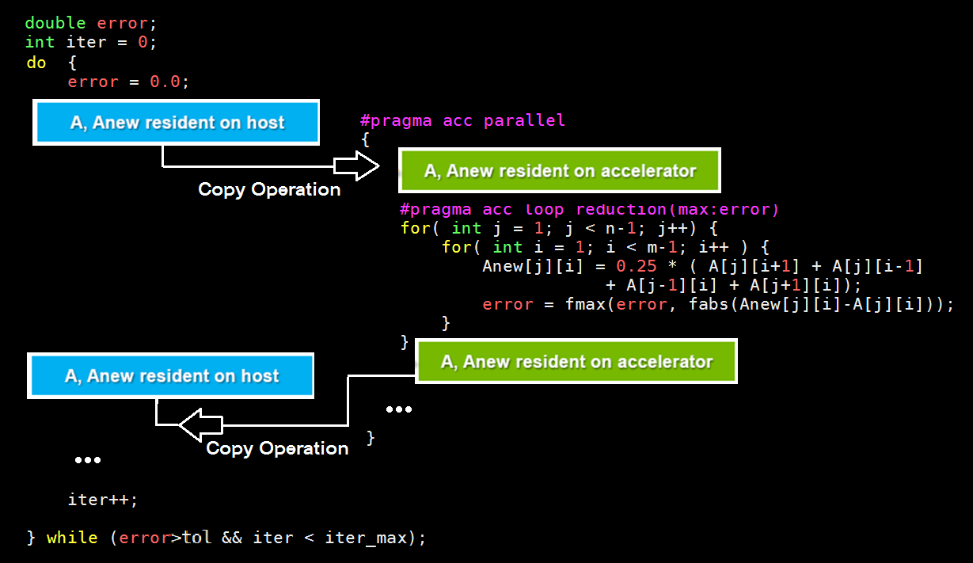
2D Jacobi Iteration – Excessive Data Transfer

Slide 55
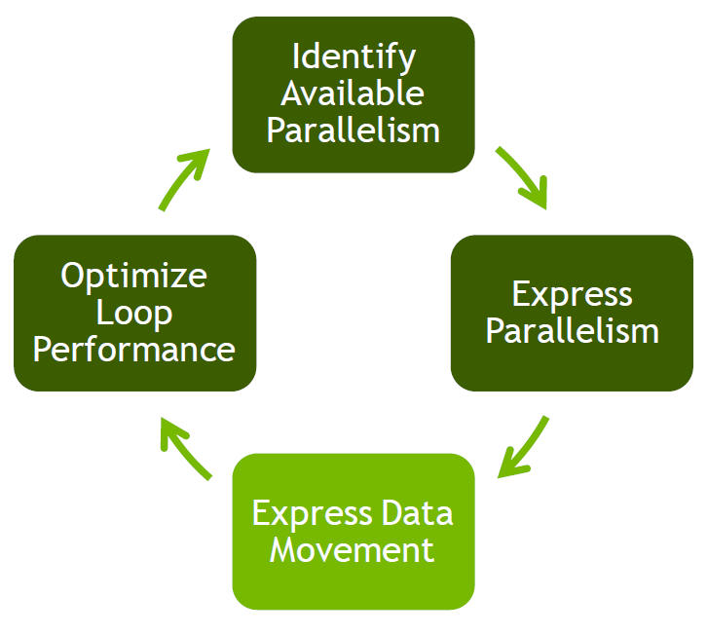

Slide 56


Slide 57
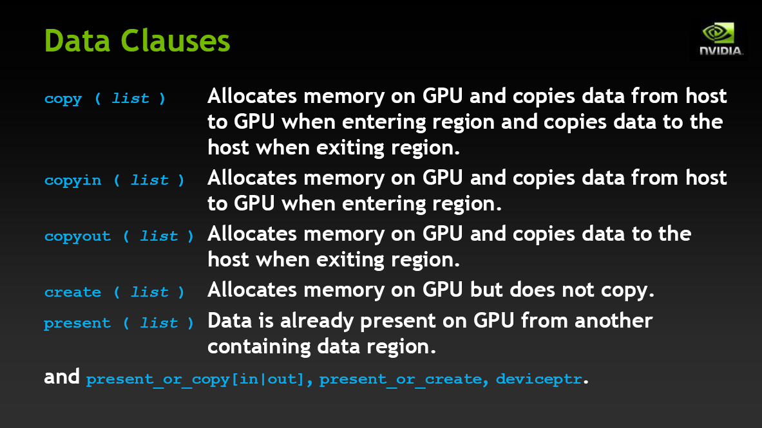

Slide 58
2D Jacobi Iteration – Express Parallelism OpenACC Solution – more expressive solution

Slide 59
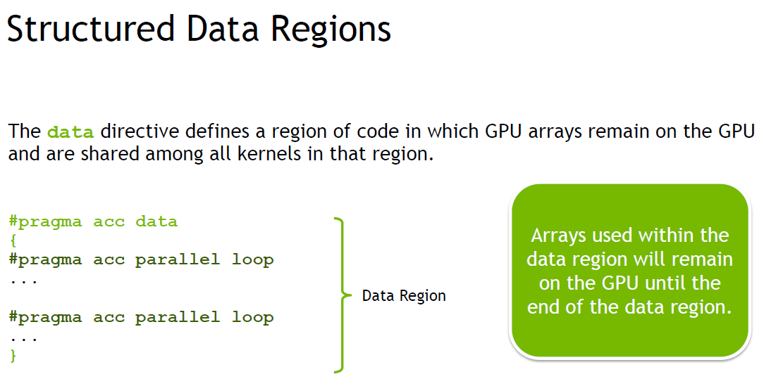

Slide 60
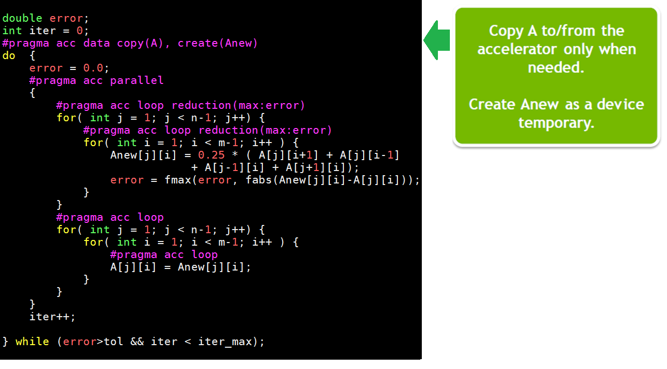
2D Jacobi Iteration – Express Parallelism OpenACC Solution – common parallel section

Slide 61
Building the Code
pgc++ laplace2d_acc.cpp -o laplace2d_acc -acc -ta=nvidia -Minfo=accel -lm -fast
main:
69, Generating copy(A[:][:])
Generating create(Anew[:][:])
73, Accelerator kernel generated
Generating Tesla code
75, #pragma acc loop gang /* blockIdx.x */
Generating reduction(max:error)
77, #pragma acc loop vector(128) /* threadIdx.x */
84, #pragma acc loop gang /* blockIdx.x */
86, #pragma acc loop vector(128) /* threadIdx.x */
73, Generating implicit copy(error)
77, Loop is parallelizable
86, Loop is parallelizable

Slide 62
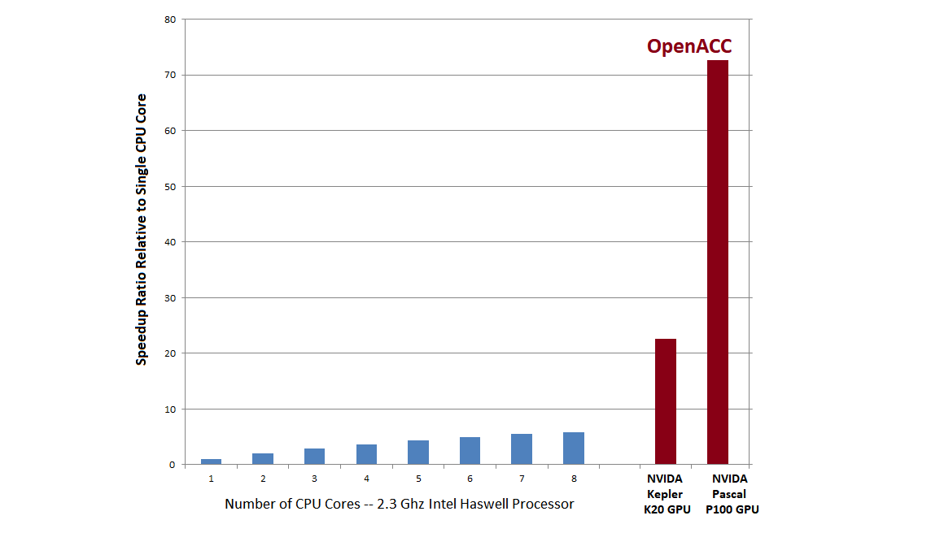
2D Laplace Measured Speedup OpenMP and OpenACC

Slide 63
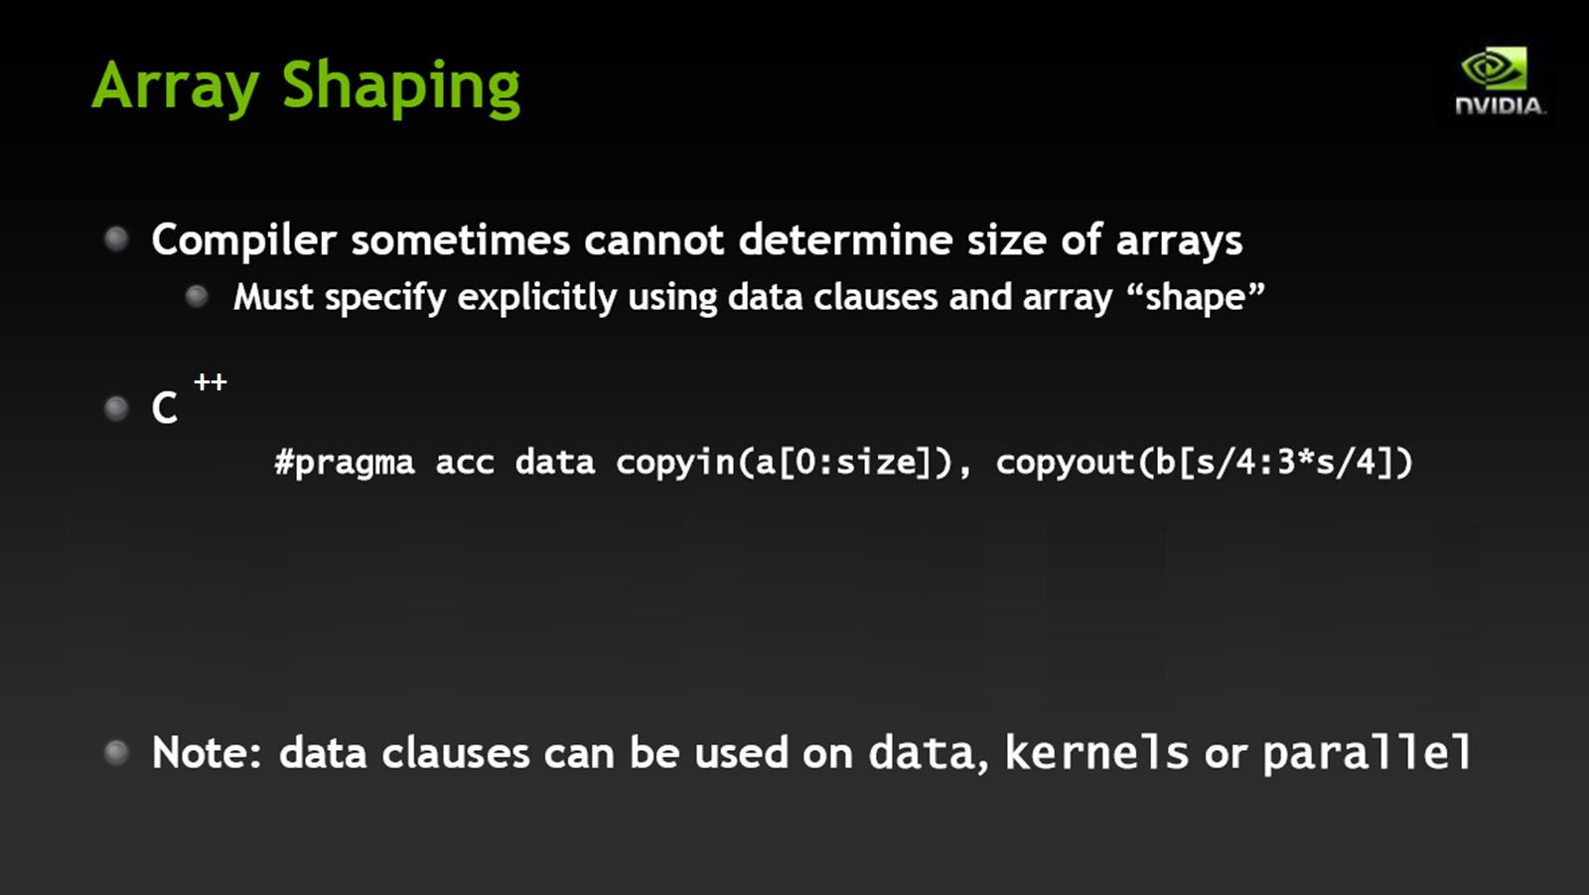

Slide 64
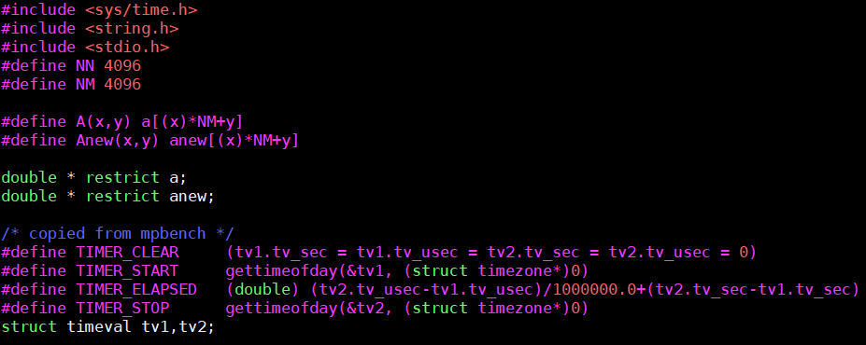
2D-Laplace Shaping Example
Also assume that the anew and a arrays are allocated dynamically
anew = new double[NN*NM]; a = new double[NN*NM];

Slide 65
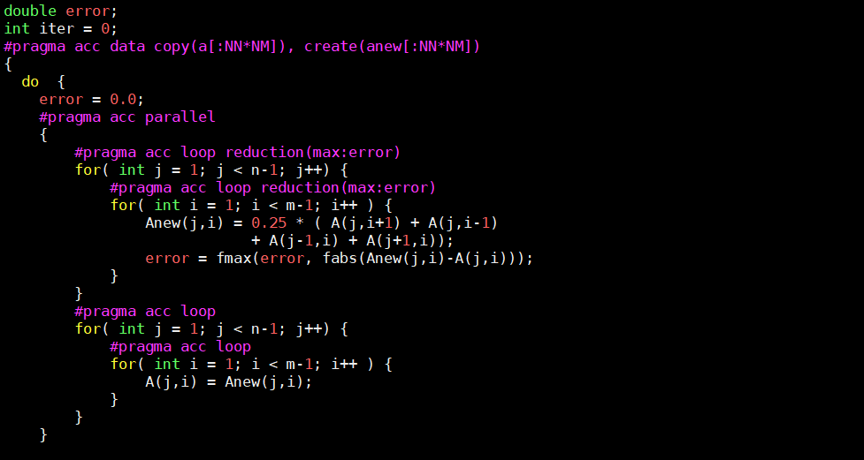
2D-Laplace Shaping Example

Slide 66
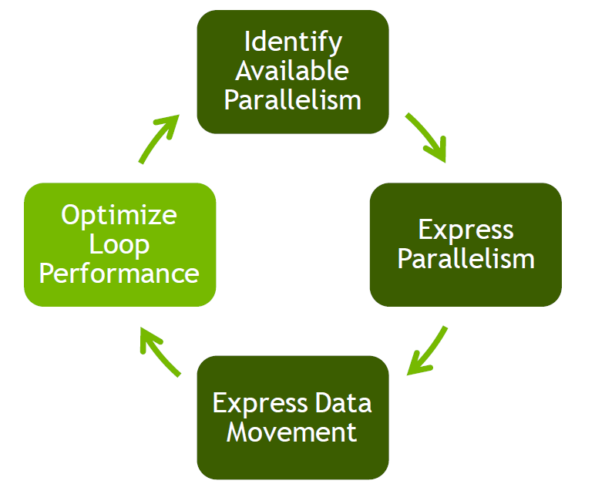

Slide 67


Slide 68


Slide 69


Slide 70


Slide 71


Slide 72


Slide 73
OpenACC Kernels Directive
Defines a region of a program that is to be compiled into a sequence of kernels for execution on the accelerator
Each loop nest will be a different kernel
Kernels launched in order in device
Specified by:
#pragma acc kernels [clause [,clause]…] new-line
structured block

Slide 74
OpenACC Kernels Directive Clauses
Kernels directive may not contain nested parallel or kernel directives.
The clauses for the !$acc kernels directive are:
copy (list)
copyin (list)
copyout (list)
create (list)
private (list)
firstprivate (list)
if( condition)
async [(scalar-integer-expression)]

Slide 75


Slide 76
OpenACC Kernels Directive Clauses
if clause
Optional clause to decide if code should be executed on accelerator or host
async clause
Specifies that a parallel accelerator or kernels regions should be executed asynchronously
The host will evaluate the integer expression of the async clause to test or wait for completion with the wait directive

Slide 77
OpenACC Kernels Directive Clauses
The clauses for the #pragma acc kernels directive are:
present (list)
present_or_copy (list)
present_or_copyin (list)
present_or_copyout (list)
present_or_create (list)
deviceprt (list)
num_gangs
num_workers
vector_length

Slide 78
OpenACC Kernels Directive Clauses
present clause
Specifies items are already present in the accelerator memory
The items were already allocated on other data, parallel or kernel regions. (i.e. inter-procedural calls)
present_or_copy clause
Tests if a data item is already present in the accelerator. If not, it will allocate the item in the accelerator and copy-in and out its value from/to the host
present_or_copyin clause
Test if a data item is already present in the accelerator. If not, it will allocate the item in the accelerator and copy-in its value from the host

Slide 79
OpenACC Kernels Directive Clauses
present_or_copyout clause
Test if a data item is already present in the accelerator. If not, it will allocate the item in the accelerator and copy-out its value to the host
present_or_create clause
Test if a data item is already present in the accelerator. If not, it will allocate the item in the accelerator (no initialization)
anew = new double[NN*NM]; a = new double[NN*NM];

Slide 80
OpenACC Update Directive
Used within a data region to update / synchronize the values of the arrays on both the host or accelerator
Specified by:
#pragma acc update [clause [,clause]…] new-line
The clauses for the !$acc update directive are:
host (list)
device (list)
if (condition)
async [( scalar-integer-expression)]

Slide 81
OpenACC Wait Directive
It causes the program to wait for completion of an asynchronous activity such as an accelerator parallel, kernel region or update directive
Specified by:
#pragma acc wait [(scalar-integer-expression)] new-line
It will test and evaluate the integer expression for completion
If no argument is specified, the host process will wait until all asynchronous activities have completed
Can be specified per CPU/Thread basis.

Slide 82
OpenACC runtime calls
int acc_get_num_devices( acc_device_t)
void acc_set_device_type(acc_device_t)
acc_device_t acc_get_device_type()
acc_set_device_num(int, acc_device_t)
int acc_get_device_num(acc_device_t)
int acc_async_test(int)
int acc_async_test_all()
void acc_async_wait(int)
void acc_async_wait_all()
void acc_init(acc_device_t)
void acc_shutdown (acc_device_t)
int acc_on_device(acc_device_t)
void* acc_malloc(size_t)
void acc_free( void*)

Slide 83
Environment Variables
export ACC_DEVICE_TYPE=NVIDIA
export ACC_DEVUCE_NUM=1

Slide 84


Slide 85


Slide 86


Slide 87


Slide 88


Slide 89


Slide 90


Slide 91


Slide 92


Slide 93


Slide 94


Slide 95


